Slide 1
Introduction to BlueROV and Simulator
34763 Autonomous Marine Robotics Course (Training)

Slide 2
Outlines
Training Activities
About BlueROV
Hardware
Software
BlueROV simulators
UUV simulator (ROS+Gazebo)
Software In The Loop with Pixhawk PX4
Ground control station - Mission planning
This week activities
Setting up simulator (using Docker)
BlueROV teleoperation simulation using ROS

Slide 3
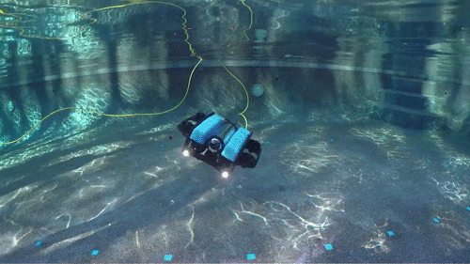
Training Activities
Getting started with simulators
Identification of linear models
Path planning 2D and 3D
Controllers tuning (PID)
Pose estimation tuning (EKF)
Neptus for mission planning
Group assignments
Deployment using real robots

Slide 4
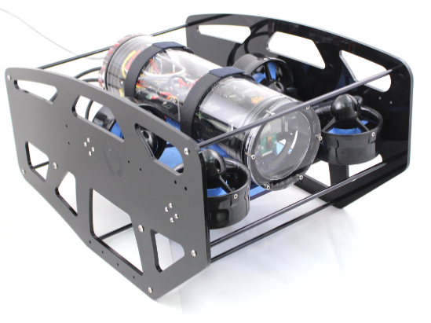
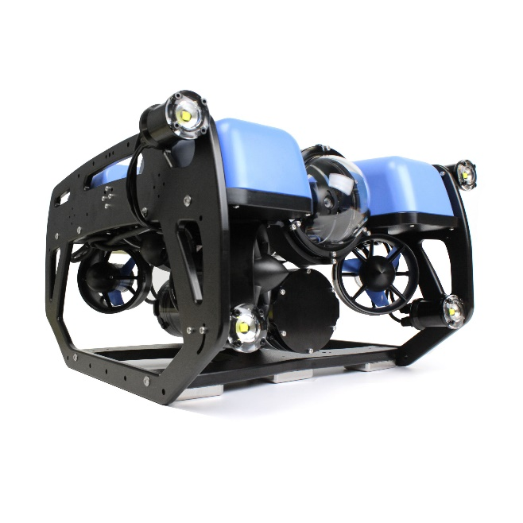
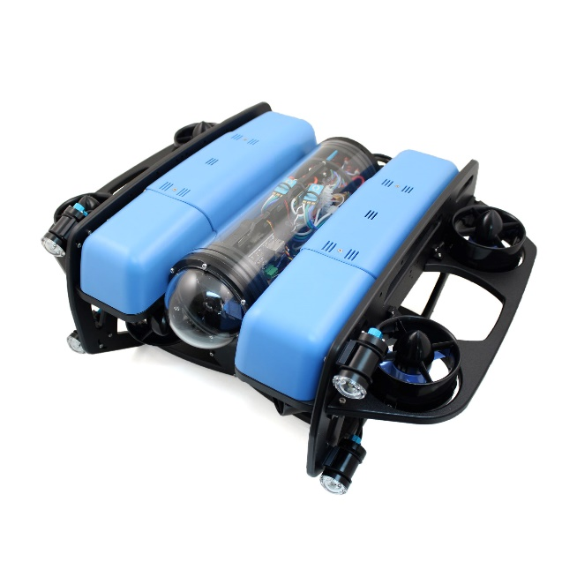
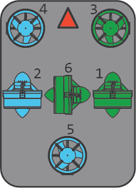
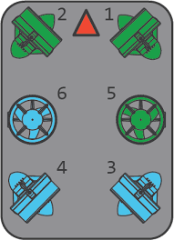
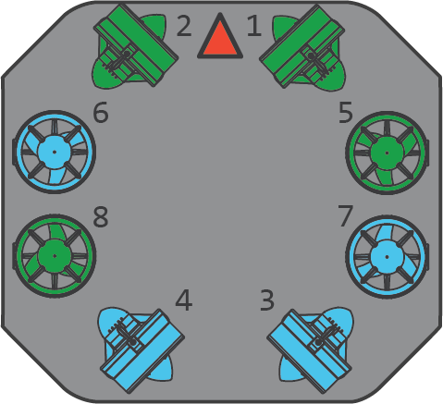
About BlueROV
BlueROV1
BlueROV2
BlueROV2 - Heavy

Slide 5
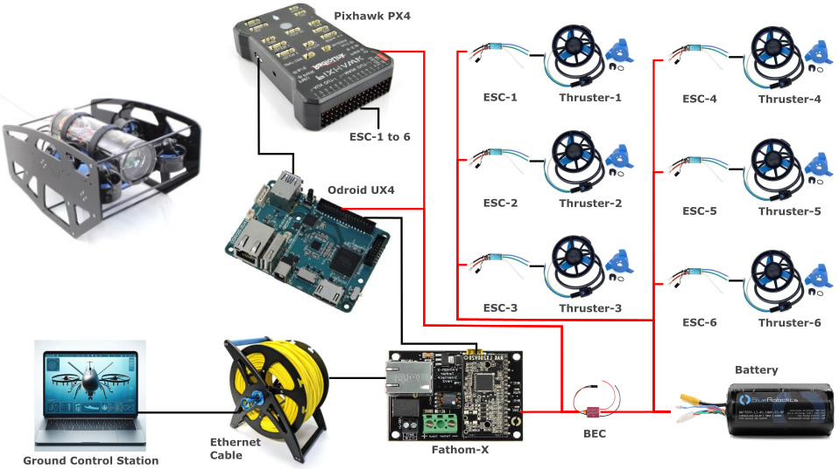
BlueROV Hardware
BlueROV1 (2016)

Slide 6
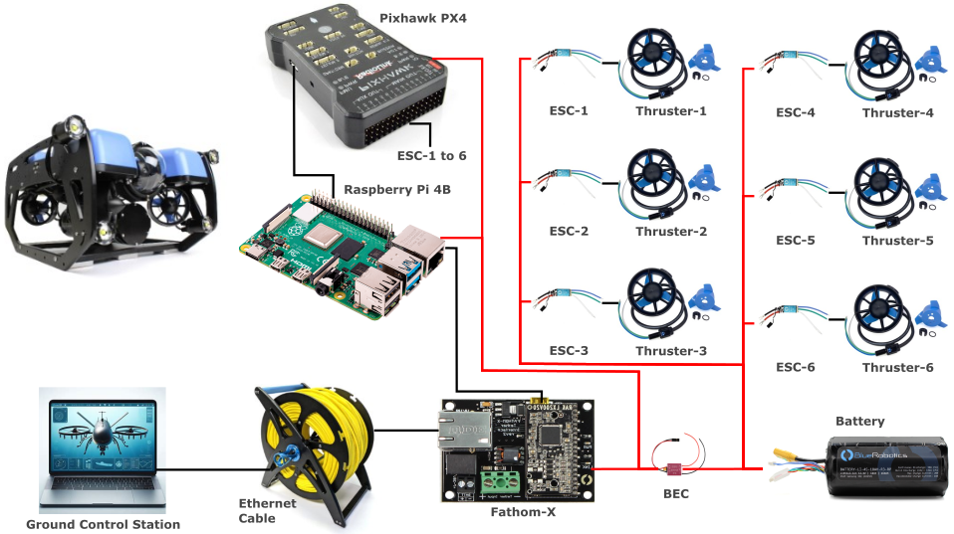
BlueROV Hardware
BlueROV2-R3

Slide 7
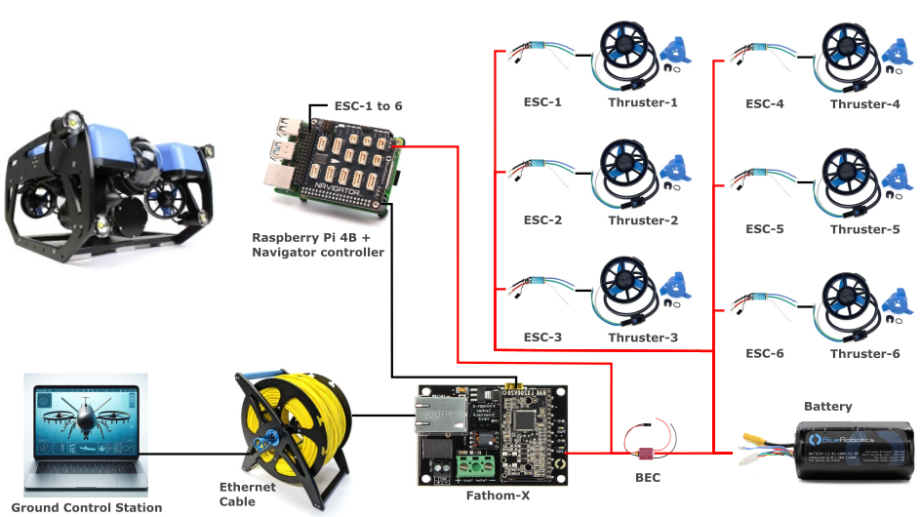
BlueROV Hardware
BlueROV2-R4 (Newest Version)

Slide 8
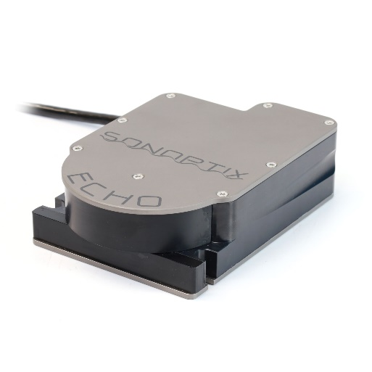
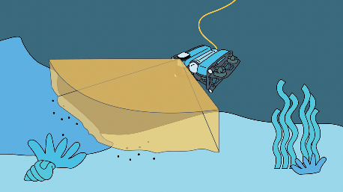
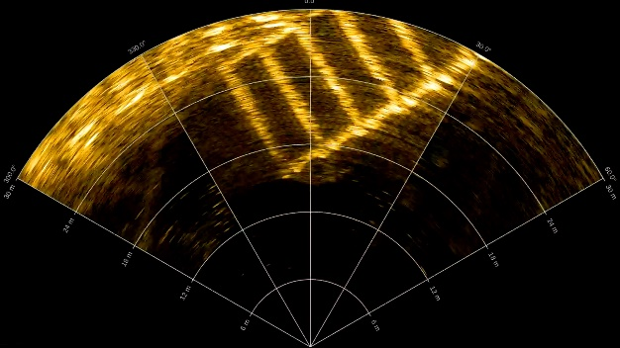
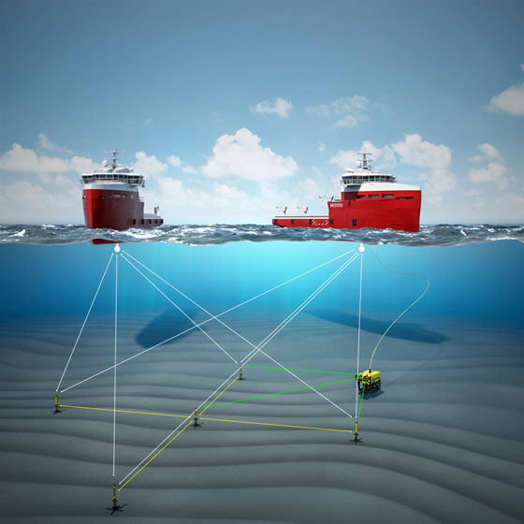
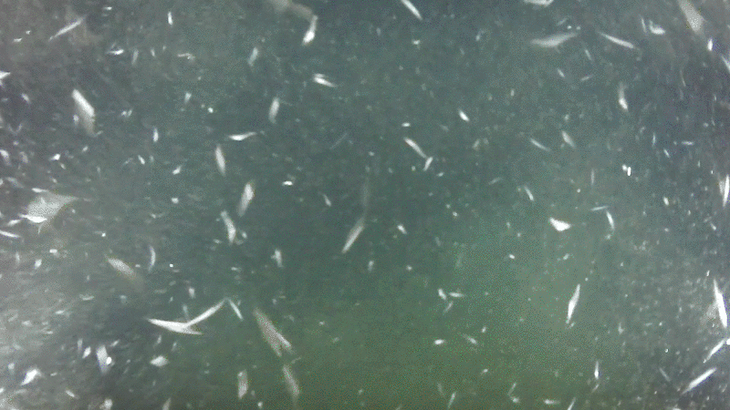
Sensors
Sonar:
Ping 1D
Side Scan Sonar
Multibeam Imaging Sonar
Water Linked DVL
IMU (Built-in Pixhawk PX4 and Navigator Controller)
Leak (Built-in Navigator Controller)
Depth/Pressure Sensor
Temperature Sensor
Low-light Camera
External Navigation Aids
HiPAP - Acoustic underwater positioning and navigation systems - Kongsberg Maritime

Slide 9
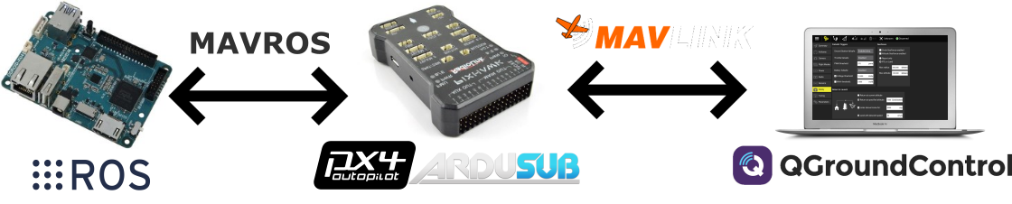
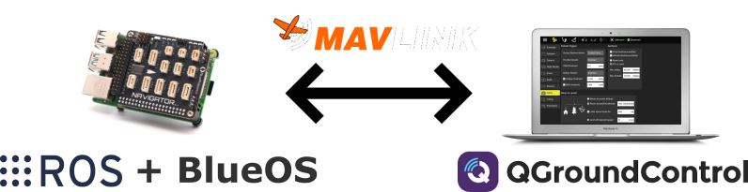
BlueROV Software
BlueROV1 until BlueROV2-R3
BlueROV2-R4

Slide 10
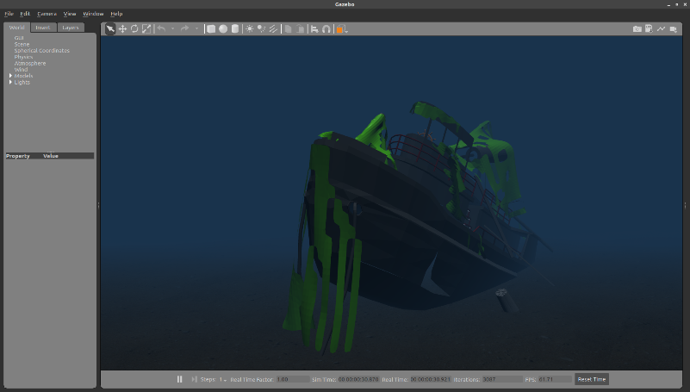
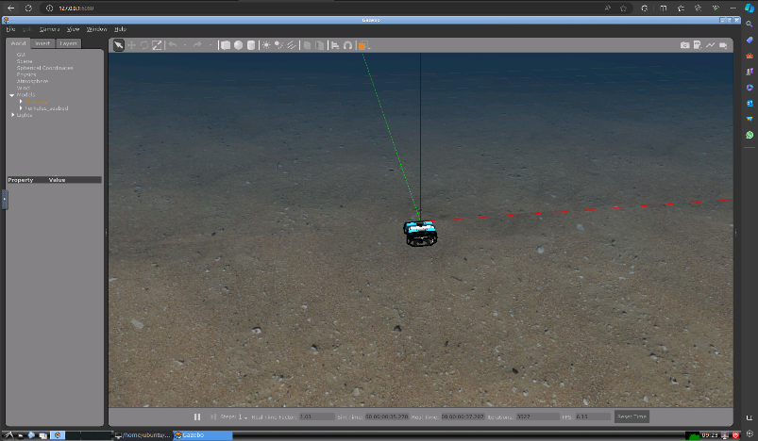

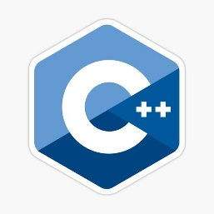
BlueROV Simulators
Gazebo + ROS (UUV Simulator)
Environmental effects: Ocean waves, buoyancy
Sensors:
Camera
Chemical concentration
Sonar
DVL
Low-level control: PID, MPC
Advanced practice: Pose estimation (EKF), SLAM
Programming languages: Python, C++
Furthermore: uuvsimulator.github.io

Slide 11
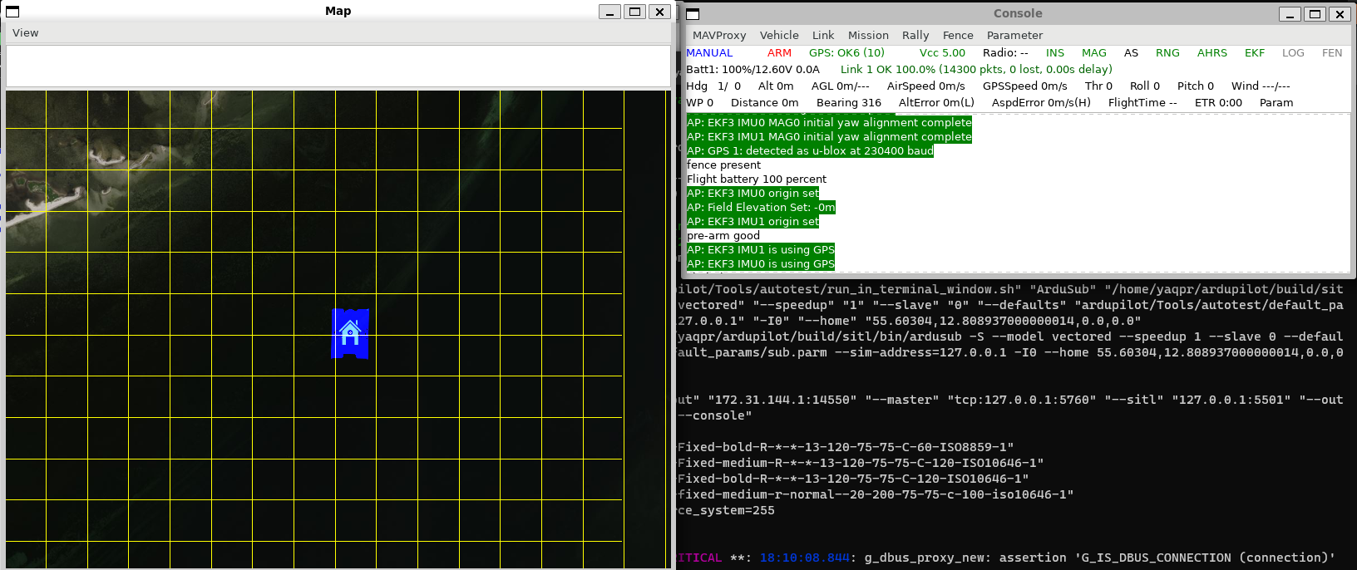
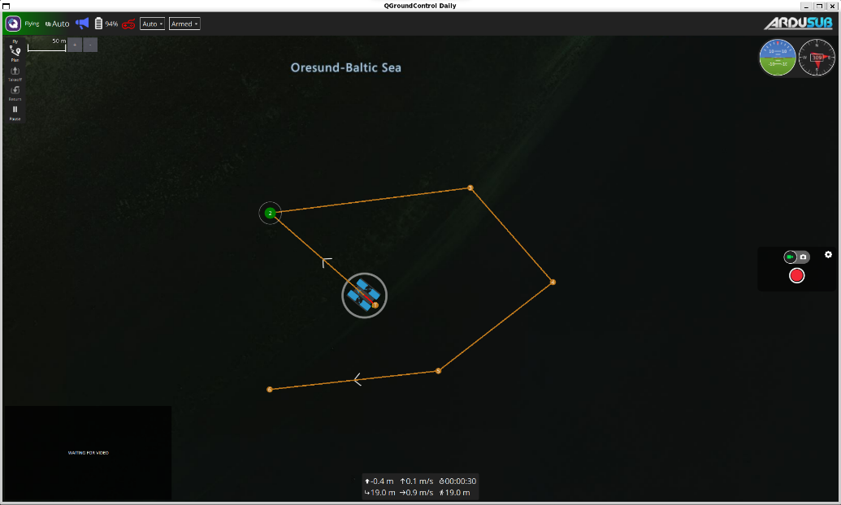
BlueROV Simulators
Software In The Loop Simulation (SITL)
Simple (Ardupilot Sim + QGroundcontrol)
Advanced (Gazebo + ROS + Ardupilot Sim + QGroundcontrol)
Ardupilot Simulator Map and Console
QGroundcontrol

Slide 12
Activities
Getting started with simulators
Docker installation
Build and run docker file
BlueROV2 manual control
Visit: bit.ly/AMR34763

Slide 13
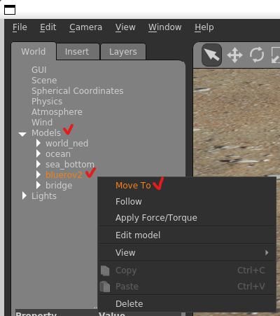
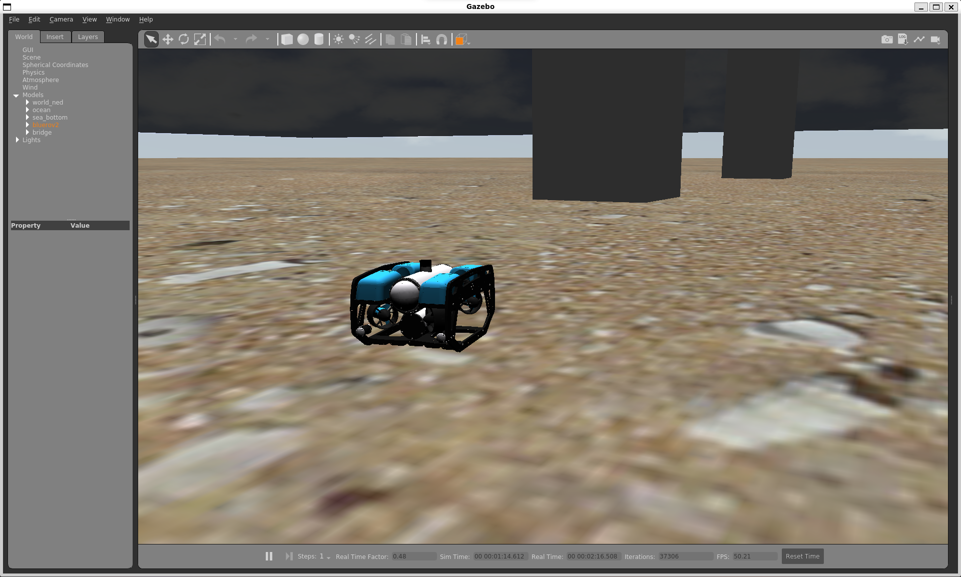
Activities
Open Gazebo and spawn the robot:
roslaunch bluerov2_gazebo start_pid_demo.launch

Slide 14
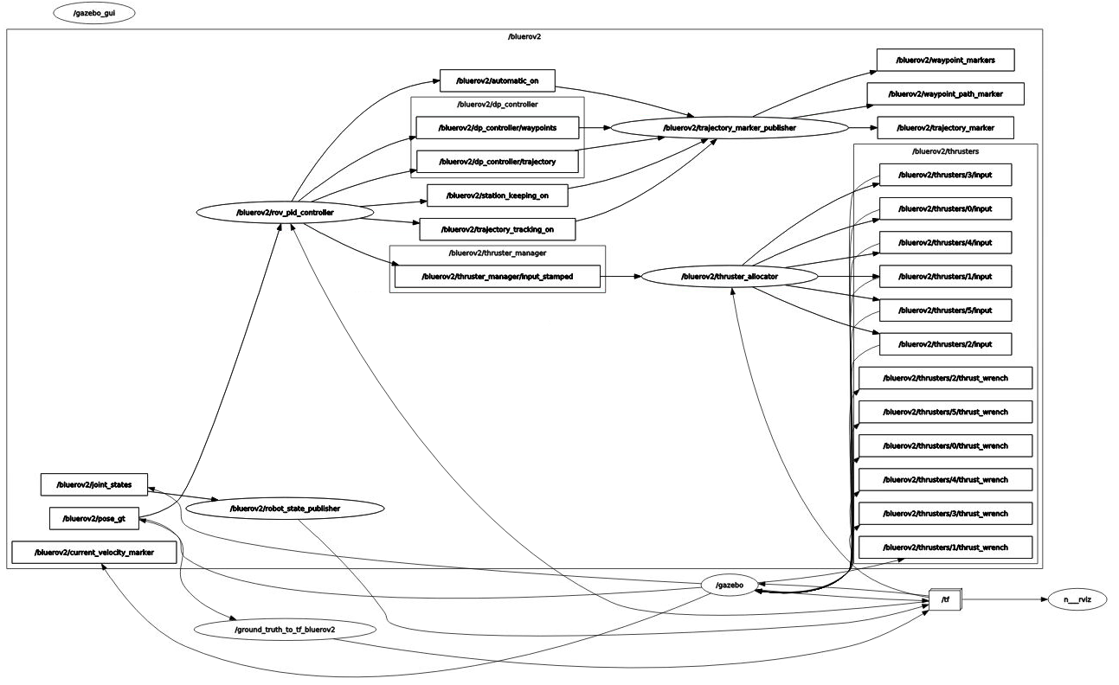
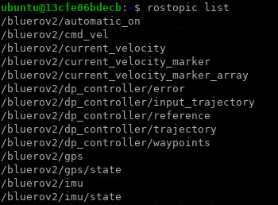
Activities
Inspect all ROS topics:
rostopic list
rostopic echo <topic_name>
rosrun rqt_graph rqt_graph

Slide 15
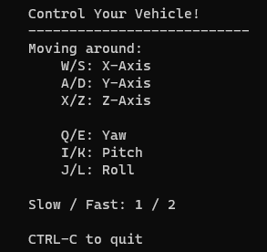
Activities
Make the robot moves by using keyboard:
roslaunch uuv_teleop uuv_keyboard_teleop.launch uuv_name:=bluerov2

Slide 16
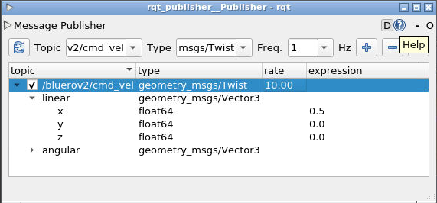

Activities
Make the robot moves using RQT publisher:
rosrun rqt_publisher rqt_publisher
Add /bluerov2/cmd_vel, change the value of linear-x to 0.5 to 1, check the checkbox to publish
You can change the rate to make the move faster
You can do experiment by changing another variable (linear y, z or angular z)

Slide 17
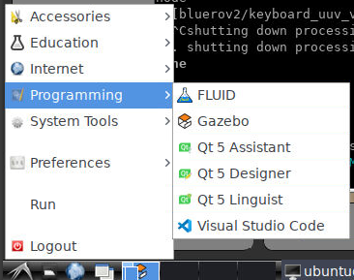
Activities
Make the robot moves using python script!
Using python script as a ROS node to publish bluerov2/cmd_vel value
How to run:
rosrun bluerov_simple_command square_wave_surge_command.py
Now, your robot should move.
You can open the project using Visual Studio Code
File –> Open Folder
Open this folder: /home/ubuntu/course_ws/src
The script is at
/home/ubuntu/course_ws/src/bluerov_simple_command/src/square_wave_surge_command.py

Slide 18
Activities
Make the robot moves to another direction!
Next, create a new python file named square_wave_heading_command.py by copying the existing file (square_wave_surge_command.py)
Change the ROS node name at line 8
Modify the file so that it publishes positive twist_msg.angular.z instead of twist_msg.linear.x
Modify the CMakeLists.txt by adding square_wave_heading_command.py
Compile the project:
cd /home/ubuntu/course_ws
catkin_make
source devel/setup.bash
Run the new file:
rosrun bluerov_simple_command square_wave_heading_command.py

Slide 19
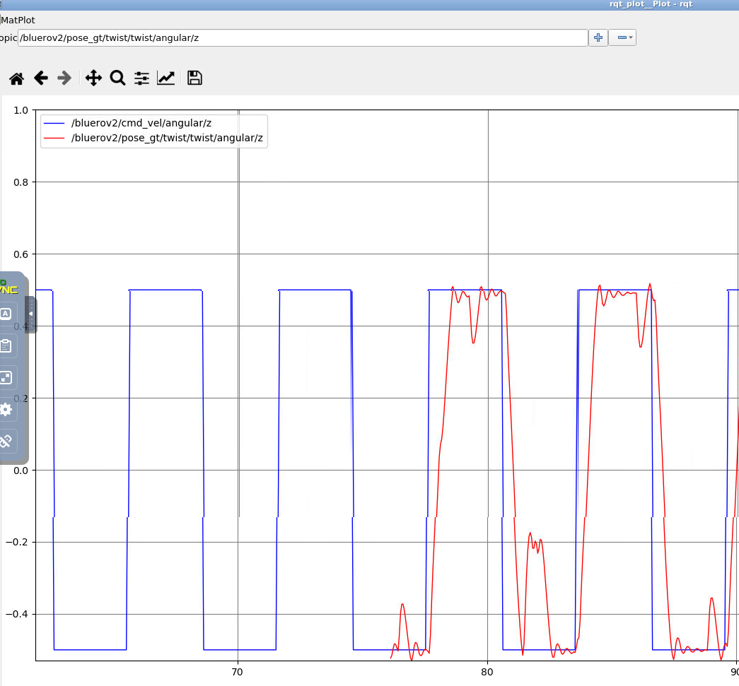
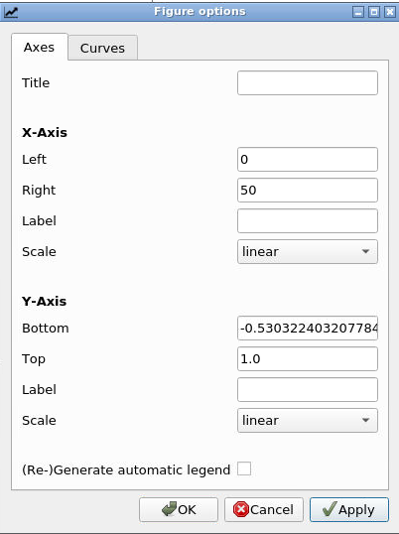

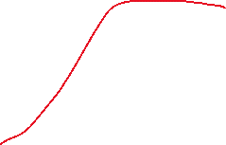
Activities
Plot the values!
rosrun rqt_plot rqt_plot

Slide 20
Activities
Save your docker container
docker commit <container_name> ros_34763_v_1
Get your container name using this command:
docker ps

Slide 21
Activities
Further reading:
Official ROS Wiki:
Documentation - ROS Wiki
ROS tutorial:
Programming for Robotics - ROS – Robotic Systems Lab | ETH Zurich

